Slide 1






SurveySum: A Dataset for Summarizing
Multiple Scientific Articles into a Survey Section
Leandro Carísio Fernandes, Gustavo Bartz Guedes, Thiago Soares Laitz, Thales Sales Almeida, Rodrigo Nogueira, Roberto Lotufo, and Jayr Pereira

Slide 2







SurveySum Authors
Leandro Carísio
Gustavo Bartz
Thiago Laitz
Thales Sales
Rodrigo Nogueira
Roberto Lotufo
Jayr Pereira

Slide 3
Our contributions
SurveySum
Survey generation pipelines
A dataset for Multi-document summarization.
Two pipelines for generating comprehensive surveys automatically.
Evaluation of both pipelines and some variations, using SurveySum.

Slide 4
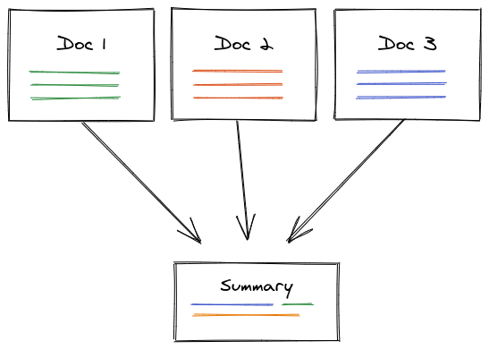
Multi-Document Summarization (MDS)
Figure source

Slide 5

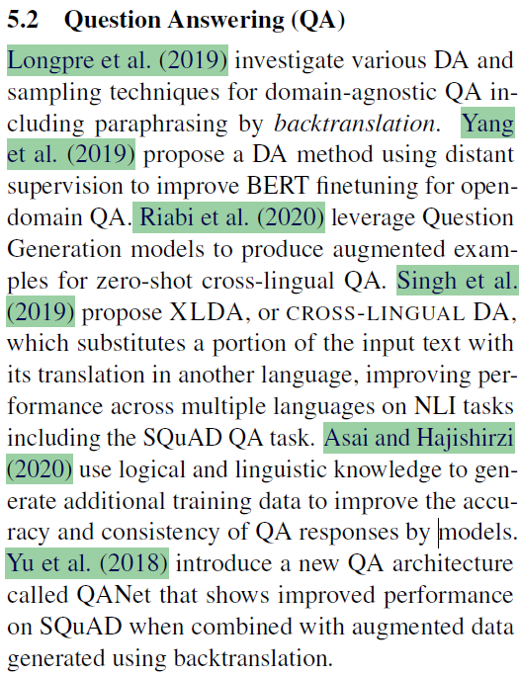
A Comprehensive Survey
A literature review
Provides a broad overview of a specific topic
Cover the most relevant and recent research in the field
Is generally divided into sections
Each section cover a specific topic
Feng et al. (2021). A Survey of Data Augmentation Approaches for NLP.

Slide 6
A comprehensive survey section is a multi-document summary.

Slide 7
The sources (i.e., the cited papers) are (generally) long documents.

Slide 8
SurveySum is a dataset for the summarization of multiple and potentially long documents!

Slide 9
SurveySum: Survey collection criteria
1. Comprehensive survey in
Fields of interest
2. Survey must be divided into sections
Fields: artificial intelligence, natural language processing, or machine learning.
Each of the sessions is also required to have at least one citation.
3. Survey Must be Freely available online
4. The survey must be written in english

Slide 10
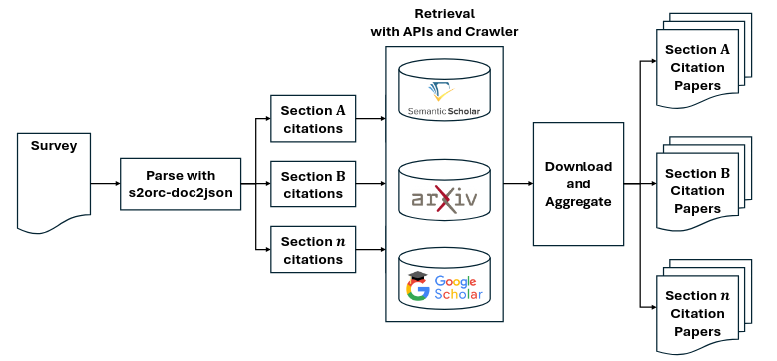
SurveySum: Dataset creation
Following the selection criteria, we gathered 6 total surveys.
Each of the surveys was parsed with s2orc-doc2json, a library to parse scientific articles to json format.
With the surveys parsed, we retrieved the name of each paper cited in each section of the surveys.

Slide 11
SurveySum: Dataset creation
Using various APIs, we retrieved the original paper for each citation present in the original surveys.
Some papers were not found automatically, in which case the authors manually retrieved the paper.

Slide 12
SurveySum: Dataset creation
With all citation papers retrieved, we aggregate them with the original survey section.

Slide 13
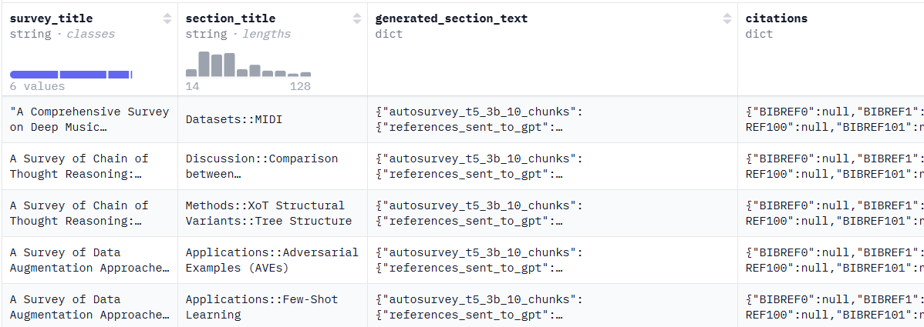
SurveySum: the Dataset
6 surveys
79 sections (i.e., summaries)
583 cited papers (i.e., source documents)
An average of ~7 papers per section
Publicly available at huggingface: https://huggingface.co/datasets/unicamp-dl/SurveySum

Slide 14
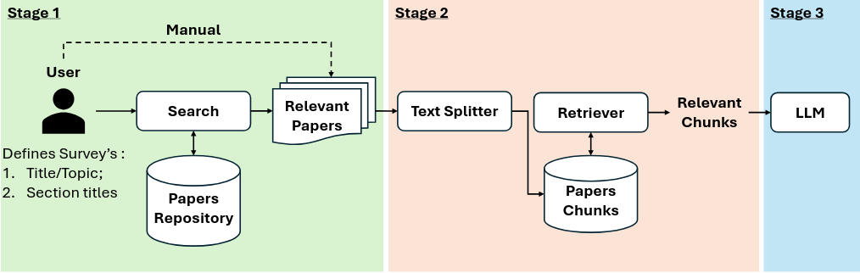
Automatic Survey generation
In the first stage the user can define the title of the survey, and the respective sections.
We also need the define the source of the papers that will be used, this can be a couple of pre selected documents, or the entirety of the papers publicly available.

Slide 15
Automatic Survey generation
Each relevant paper has it's text extracted and splitted in chunks.
We them apply a retriever, using the section title as the query, to retrieve the most relevant chunks for that section.

Slide 16
Automatic Survey generation
With the relevant chunks, we ask a LLM to generate the final survey text.
In this work we choose to limit the LLMs used to gpt-3.5-turbo and gpt-4-preview.

Slide 17
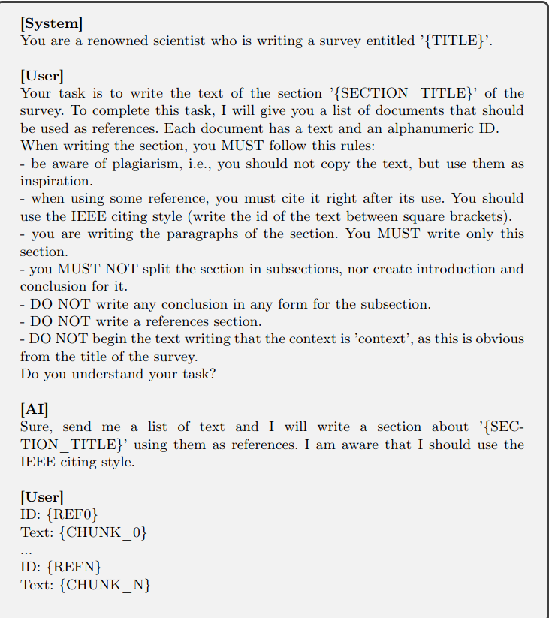
Automatic Survey generation
Retrieved chunks

Slide 18
Automatic Survey generation - pipelines
Pipeline 1
Pipeline 2
Uses a MonoT5 reranker model as a retriever.
Uses a few-shot prompt for text generation
Uses the SPECTER2 model to generate embeddings for each chunk, and uses these embeddings for retrieval.
Uses a single shot prompt with more complex instructions.

Slide 19
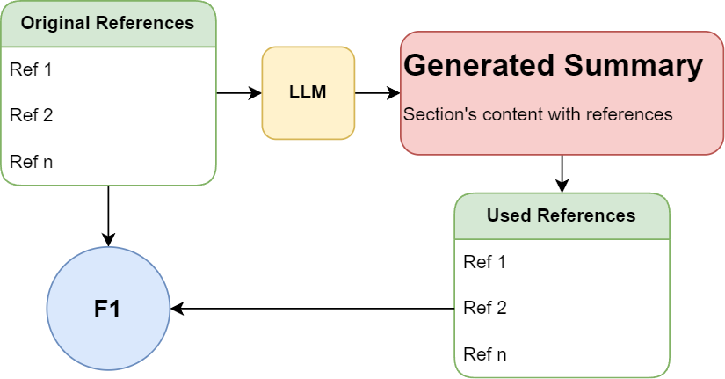
Evaluation metrics - Reference f1
F1 score is used to evaluate the ability of LLMs to use the same references in their summaries as those found in the original text written by humans.

Slide 20
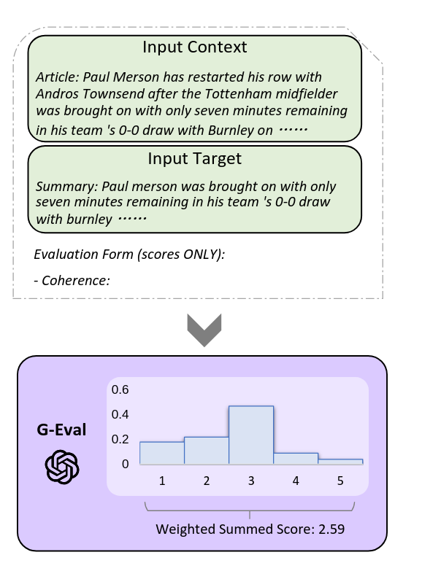
Evaluation metrics - G-eval
G-eval is a metric for evaluation content generated by llms that showed a high correlation with human preference.
G-eval generates an score for the provided text with an LLM using a high temperature, the score is sampled 20 times.
The final G-eval score is the weighted sum of the scores, weighted by the probability of the judge model to give scre.
G-EVAL: NLG Evaluation using GPT-4 with Better Human Alignment

Slide 21

Evaluation metrics - CheckEval
The Check-Eval metric evaluates the consistency between the candidate text and the reference text using an evaluation checklist.
The checklist is generated by a LLM model, which is then used to evaluate the candidate text.
if the evaluation checklist consists of ten elements and the candidate text includes eight of these, the Check-Eval score will be 0.8.
Check-Eval: A Checklist-based Approach for Evaluating Text Quality

Slide 22
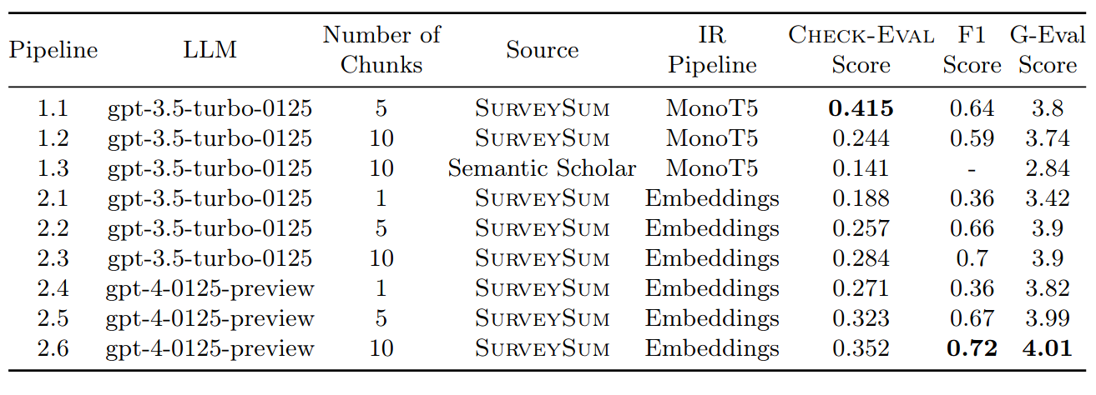
Results
Check-Eval and G-eval show a high correlation.
G-eval presents a much lower variability

Slide 23
Results - More chunks is always better?
Increasing the number of chunks did not always bring better results.
Worse with more chunks
Better with more chunks

Slide 24
Results - The importance of the LLM
When changing only the LLM used for writing the section, the result always improved when using a more capable LLM.

Slide 25
Results - The importance of the source
When using all documents available in Semantic Scholar, instead of the pre selected documents from SurveySum. The result was much worse.
The quality of documents automatically retrieved from SS, was much worse, resulting in a worse generated section.

Slide 26
Conclusions
Importance of Source Papers: High-quality and relevant source papers are crucial for accurate and coherent summaries.
Role of LLM Quality: Advanced models like GPT-4 significantly outperform earlier versions, highlighting their impact on summary quality.
Pipeline Insights: Effective retrieval and selection of text chunks enhance summarization outcomes but depend on robust retrievers.
Benchmark Contribution: SurveySum provides a benchmark for developing and evaluating multi-document summarization models in scientific contexts.
Github: https://github.com/unicamp-dl/surveysum

Slide 27
Obrigado!
SurveySum: A Dataset for Summarizing Multiple Scientific Articles into a Survey Section

